Slide 1

Factors that Affect the Adoption of DSH and DMH Cats
A Case Study at the Louisville Metro Animal Services (LMAS) Shelter
By Jonathan Fivelsdal

Slide 2
Background
The ASPCA says that about 6.5 million companion animals that enter shelters in the U.S. every year, 3.2 million are cats¹
Two common types of cats are the domestic shorthair cat (DSH) and domestic mediumhair cat (DMH)
The pet insurance website Pet Premium says that DSH cats possess a medium amount of activity and affection while DMH cats tend to have low affection and activity levels^{2,3}
1 “Pet Statistics.” ASPCA, The American Society for the Prevention of Cruelty to Animals, Accessed 11 January 2019, https://www.aspca.org/animal-homelessness/shelter-intake-and-surrender/pet-statistics
2 “Domestic Shorthair.” PetPremium, PetPremium, Inc., Accessed 12 January 2019, https://www.petpremium.com/cat-breeds/domestic-shorthair/
3 “Domestic Mediumhair.” PetPremium, PetPremium, Inc., Accessed 12 January 2019, https://www.petpremium.com/cat-breeds/domestic-medium-hair/

Slide 3
Shelter Data
Louisville Metro Animal Services (LMAS) provides data on the animals in their shelter on the Louisville Open Data website
Data From January 1st 2017 to December 31st 2017 on DSH and DMH cats from LMAS was analyzed to establish significant factors that affect adoption
The analysis that was conducted in the R programming language⁴

Slide 4
Research and Statistical Questions
How does the length of time spent in the shelter and age affect adoption ?
How does the adoption of stray cats differ from that of non-stray cats ?
Is the proportion of DSH cats that are adopted from the shelter different from the proportion of DMH cats that are adopted ?

Slide 5
Variables of Interest
The variables of interest are age, length of stay (LOS) and stray status
Age is defined such that cats that are less than 1 year old are kittens, cats that are at least 1 year old but less than seven years old are young adult and cats that are seven years of age or older are older adult cats⁵
A case study of the Guelph Humane Society noted that previous research suggests that age was the most important factor that adopters considered when choosing to adopt a cat⁶

Slide 6
Variables of Interest (Continued)
A study was conducted in which the average time for owner surrendered cats and stray cats to develop an illness after entering a shelter was measured to be 11 and 14 days respectively⁷
Weeks is a binary variable that represents LOS in the analysis. This variable differentiates between cats that stay more than 2 weeks and those that don’t
Stray is a binary variable that differentiates between cats that are identified as stray versus cats that are not

Slide 7
Variables of Interest (Continued)
Research indicates that potential adopters tend to have preconceived notions about stray cats that negatively affects their chances of being adopted⁸
Different statistical models were tested to see if the other variables (age and weeks) significantly interact with the stray variable

Slide 8
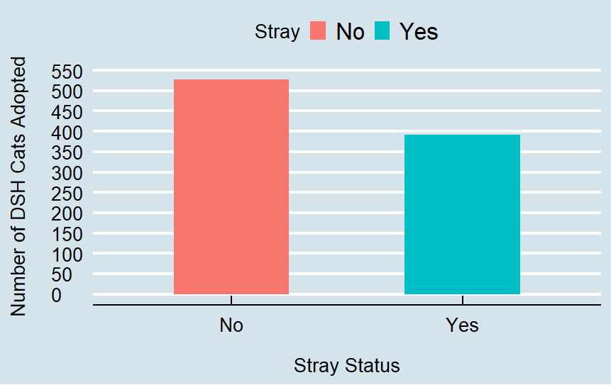
DSH Cats Adopted By Stray Category
The plot above indicates that about 525 non-stray DSH cats and about 400 stray DSH cats were adopted. This plot suggests that there is a negative relationship between stray status and adoption.

Slide 9
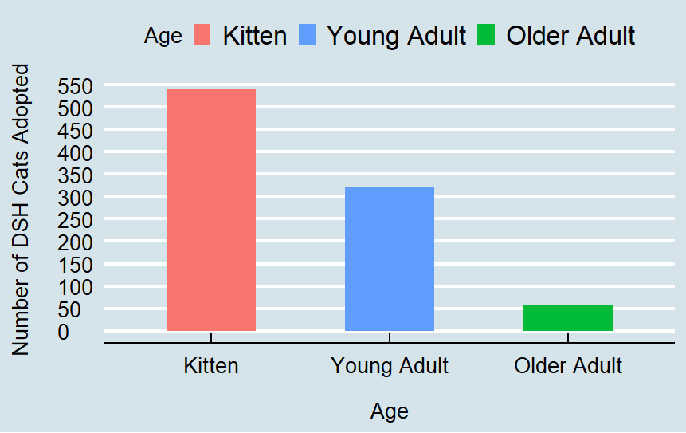
DSH Cats Adopted By Age Category
The graph shows that a little less than 550 kittens, about 325 young adult cats and a little more than 50 older adult cats were adopted among the DSH cats in the shelter. This plot suggests that is a negative relationship between age and adoption.

Slide 10
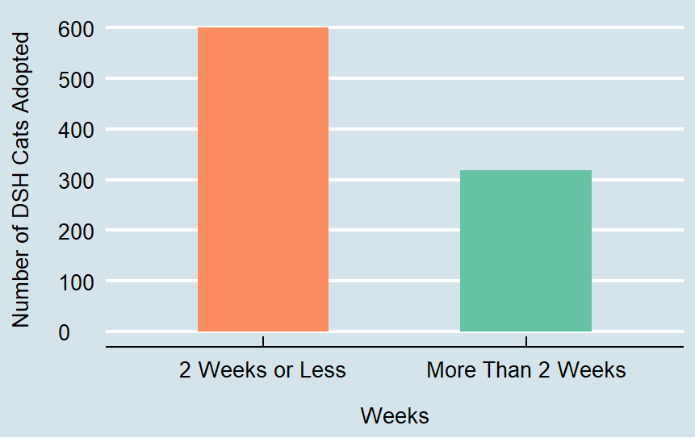
DSH Cats Adopted By Weeks
The bar graph shows that 600 DSH cats that spent two weeks or less in the shelter were adopted while a little more than 300 DSH cats that spent more than 2 weeks in the shelter were adopted. Thus, it appears that spending more than 2 weeks in a shelter has a negative impact on adoption.

Slide 11
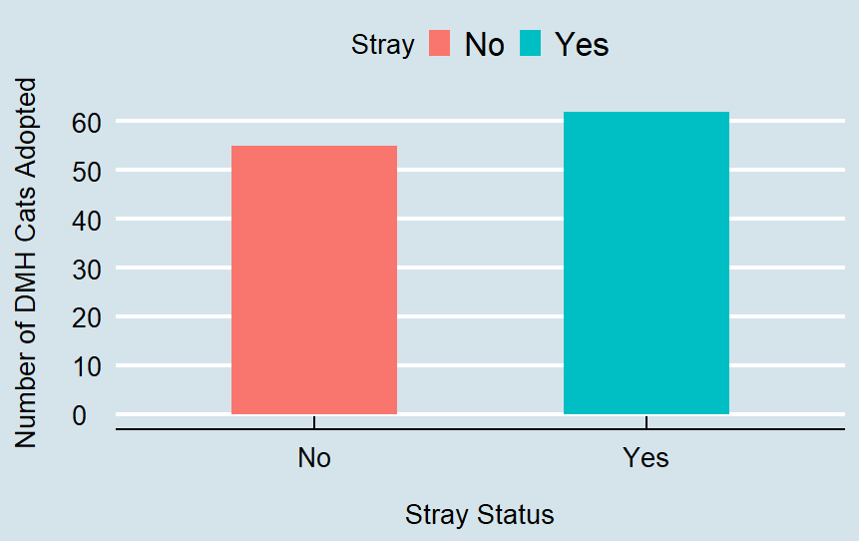
DMH Cats Adopted By Stray Category
The plot suggests that there might be a positive relationship between stray status and adoption, but when statistical models are considered later, the direction of the relationship between the stray status of DMH cats and the adoption of DMH cats may change when more factors are considered.

Slide 12
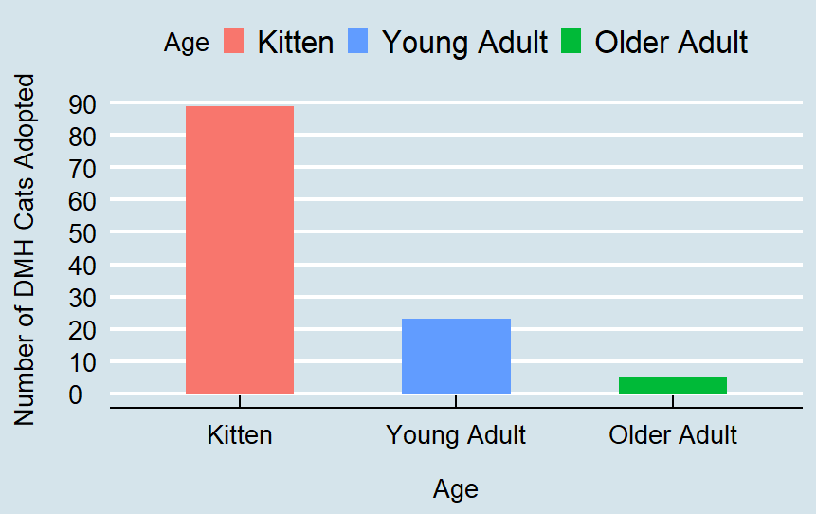
DMH Cats Adopted By Age Category
The plot shows that about 90 kittens, a little more than 20 young adult cats and about 5 older adult cats were adopted among the DMH cats in the shelter. This plot suggests that there is a negative relationship between age and adoption.

Slide 13
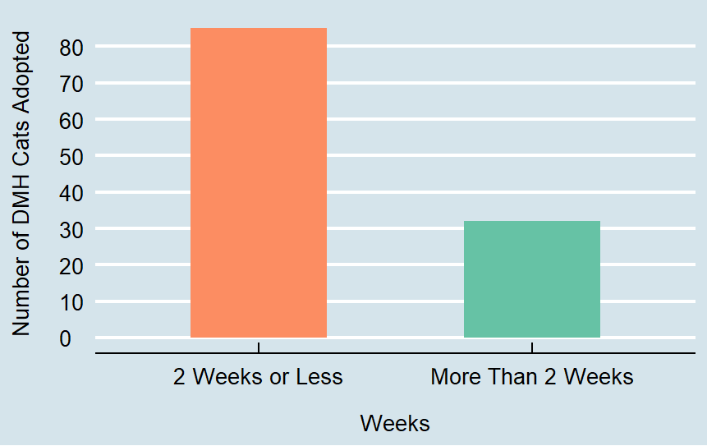
DMH Cats Adopted By Weeks
It appears that for DMH cats that spending more than 2 weeks in the shelter has a negative effect on adoption.

Slide 14
Number and Proportion of DSH and DMH Cats Adopted
 | Domestic Shorthair Cat | Domestic Mediumhair Cat
Sample Size | 2945 | 330
Number Adopted | 919 | 117
Estimate Proportion | 919/2945 = 0.3121 | 117/330 = 0.3545
From the 2945 DSH cats admitted to the Louisville Metro Animal Services (LMAS) shelter in 2017, 919 of these cats were adopted. Out of the 330 DMH cats that were admitted to LMAS in 2017, 117 of these cats were adopted.

Slide 15
Difference of Proportion Test (DSH vs. DMH)
 | Adopted | Not Adopted
Domestic Shorthair | 31.21% | 68.79%
Domestic Mediumhair | 35.45% | 64.55%
A difference of proportions test was performed and the p-value resulting from the test is 0.116 and thus no significant difference in the proportion of DSH cats adopted versus the proportion of DMH cats adopted.

Slide 16
Methods of Analysis
Logistic regression is used in cases where the outcome is a binary or yes/no type of response.
Adoption is a yes/no type of outcome (was a cat adopted or not from a shelter?) and so logistic regression is an appropriate method to consider when examining what factors affect whether or not a cat is adopted.
A logistic regression model was used to examine factors affecting adoption for DSH and DMH cats.

Slide 17
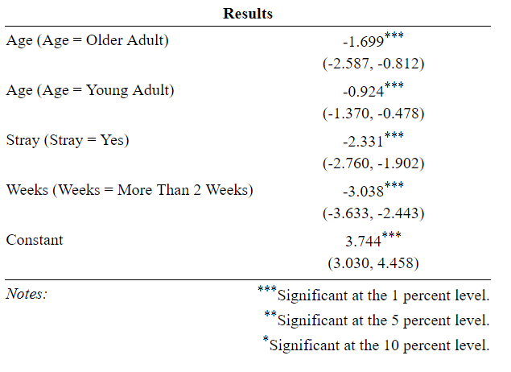
DSH Cat Regression Table
Above are the coefficients from the logistic regression created for DSH cats.
The next slide will include odds ratios which are derived from the coefficients in the logistic regression results presented in the above table.

Slide 18
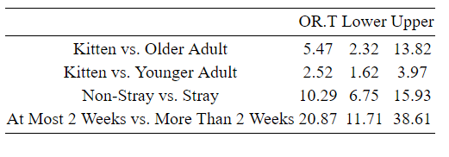
Reciprocal of Odds Ratio for DSH Logistic Regression Model Factors

Slide 19
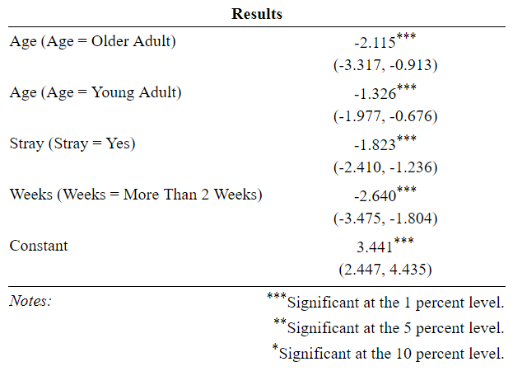
DMH Regression Table
Above are the coefficients from the logistic regression created for DSH cats.
The next slide will include odds ratios which are derived from the coefficients in the logistic regression results presented in the above table.

Slide 20
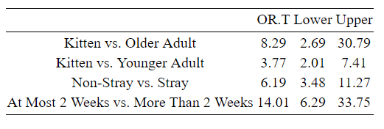
Reciprocal of Odds Ratio for DMH Logistic Regression Model Factors

Slide 21
Summary of Results
The direction of the relationships between the age, stray and weeks variable are the same for both DSH and DMH cats
Older adult cats and young adult cats are less likely to be adopted than kittens
Stray cats are less likely to be adopted than non-stray cats
Cats that stay more than two weeks are less likely to be adopted than cats that stay two weeks or less in the shelter

Slide 23
Recommendations for Increasing Adoption
Shelter staff could speak to adopters about benefits of adopting an older cat
Dydball and Strasser suggest that “working with cats to increase social behaviors or add toys in the kennels of stray cats to improve adopter perception” ⁹
Colorful collars, moving animals to an offsite location, displaying overlooked cats in the shelter lobby, updating photos and descriptions of cats seen online and promotions done on traditional media and social media can increase adoption among stray cats¹⁰
9 Dybdall, Kathryn & Strasser, Rosemary. (2014). Is There a Bias Against Stray Cats in Shelters? People's Perception of Shelter Cats and How It Influences Adoption Time.
10 Reider, Linda. “Overlooked No More.” Animal Sheltering Online by The Humane Society of the United States, 2 Sept.
2016, www.animalsheltering.org/magazine/articles/overlooked-no-more.

Slide 24
Reference List
1 “Pet Statistics.” ASPCA, The American Society for the Prevention of Cruelty to Animals, Accessed 11 January 2019, https://www.aspca.org/animal-homelessness/shelter-intake-and-surrender/pet-statistics
2 “Domestic Shorthair.” PetPremium, PetPremium, Inc., Accessed 12 January 2019, https://www.petpremium.com/cat-breeds/domestic-shorthair/
3 “Domestic Mediumhair.” PetPremium, PetPremium, Inc., Accessed 12 January 2019, https://www.petpremium.com/cat-breeds/domestic-medium-hair/
4 R Core Team (2018). R: A language and environment for statistical computing. R Foundation for Statistical Computing, Vienna, Austria. URL https://www.R-project.org/.
5 Downing, Robin. “Feeding Your Young Adult Cat.” VCA Hospitals, Accessed 15 January 2019, vcahospitals.com/know-your-pet/feeding-your-young-adult-cat.
6 Janke et.al. Risk factors affecting length of stay of cats in an animal shelter: A case study at the Guelph Humane Society, 2011-2016. Prev Vet Med. 2017 Dec 1;148: 44-48. doi:10. 1016/j.prevetmed.2017.10.007. Epub 2017 Oct 16. PubMed PMID: 29157373.

Slide 25
Reference List (Continued)
7 Dybdall, Kathryn & Strasser, Rosemary & Katz, Tanja. (2006). Behavioral differences between owner surrender and stray domestic cats after entering an animal shelter. Applied Animal Behaviour Science. 104. 10.1016/j.applanim.2006.05.002.
8 Dybdall, Kathryn & Strasser, Rosemary. (2014). Is There a Bias Against Stray Cats in Shelters? People's Perception of Shelter Cats and How It Influences Adoption Time. Anthrozoos A Multidisciplinary Journal of The Interactions of People & Animals. 28. 603-614. 10.2752/089279314X14072268688087.
9 Dybdall, Kathryn & Strasser, Rosemary. (2014). Is There a Bias Against Stray Cats in Shelters? People's Perception of Shelter Cats and How It Influences Adoption Time.
10 Reider, Linda. “Overlooked No More.” Animal Sheltering Online by The Humane Society of the United States, 2 Sept.2016, www.animalsheltering.org/magazine/articles/overlooked-no-more.

